Slide 1



Developing a Project Plan
(25CPE4602)
Lecture 6
Dr. Zahraa Ismail

Slide 2
Developing the Project Network
The project network is the tool used for planning, scheduling, and monitoring project progress.
It is developed from the information collected for the WBS and is a graphic flow chart of the project job plan.
It illustrates the project activities that must be completed, the logical sequences, the interdependencies of the activities to be completed, and in most cases the times for the activities to start and finish along with the longest path(s) through the network—the critical path.
It is the framework for the project information system that will be used by the project managers to make decisions concerning project time, cost, and performance.
2
Notes:
شبكة المشروع هي الأداة المستخدمة لتخطيط وجدولة ومراقبة تقدم المشروع. تُطوّر هذه الشبكة من المعلومات المُجمّعة لهيكل تقسيم العمل (WBS)، وهي عبارة عن مخطط انسيابي بياني لخطة عمل المشروع. توضح الشبكة أنشطة المشروع التي يجب إكمالها، والتسلسلات المنطقية، والترابطات بين الأنشطة المطلوب إكمالها، وفي معظم الحالات، أوقات بدء وانتهاء الأنشطة، بالإضافة إلى أطول مسار (مسارات) عبر الشبكة - المسار الحرج. وهي الإطار الذي يعتمد عليه مديرو المشاريع لاتخاذ القرارات المتعلقة بوقت المشروع وتكلفته وأدائه.

Slide 3
Importance of the Project Network
The network is easily understood by others because It presents a graphic display of the flow and sequence of work through the project.
It is very easy to modify or change when unexpected events occur as the project progresses.
It provides the basis for scheduling labor and equipment.
It enhances communication that blends all managers and groups together in meeting the time, cost, and performance objectives of the project.
It provides an estimate of project duration rather than picking a project completion date from someone’s preferred date.
It gives the times when activities can start and finish and when they can be delayed.
It provides the basis for budgeting the cash flow of the project.
It identifies which activities are “critical” and, therefore, should not be delayed if the project is to be completed as planned. It highlights which activities to consider if the project needs to be compressed to meet a deadline.
3
Notes:
الشبكة سهلة الفهم للآخرين لأنها تُقدم عرضًا بيانيًا لتدفق وتسلسل العمل خلال المشروع.
من السهل جدًا تعديلها أو تغييرها عند حدوث أحداث غير متوقعة أثناء تقدم المشروع.
تُوفر أساسًا لجدولة العمل والمعدات.
تُعزز التواصل الذي يجمع جميع المديرين والمجموعات معًا لتحقيق أهداف الوقت والتكلفة والأداء للمشروع.
تُقدم تقديرًا لمدة المشروع بدلاً من اختيار تاريخ إنجاز المشروع من تاريخ مُفضل لشخص ما.
تُحدد أوقات بدء الأنشطة وانتهائها ومتى يُمكن تأجيلها.
تُوفر أساسًا لوضع ميزانية التدفق النقدي للمشروع.
تُحدد الأنشطة "الحرجة"، وبالتالي لا ينبغي تأخيرها إذا كان من المقرر إكمال المشروع كما هو مُخطط له. وتُسلط الضوء على الأنشطة التي يجب مراعاتها إذا كان المشروع بحاجة إلى ضغط للوفاء بالموعد النهائي.
Network diagrams serve multiple purposes in project management. Let’s explore the key objectives they help achieve:
Understanding the Project Scope
Network diagrams help project managers and stakeholders gain a comprehensive understanding of the project’s scope. By visually representing the project’s activities and their relationships, network diagrams provide a holistic view of the project’s intricacies and deliverables.
Identifying Critical Path
The critical path of a project is the sequence of activities that will take the longest time to complete and determines the project’s overall duration. Network diagrams enable project managers to identify the critical path by analyzing the dependencies and durations of activities. This helps in resource planning and ensures that project timelines are met.
Estimating Project Duration
By analyzing the relationships and durations of activities, network diagrams assist in estimating the project’s duration. Project managers can identify the activities that might cause delays and take necessary actions to mitigate risks. Accurate project duration estimation helps allocate resources effectively and set realistic expectations for project stakeholders.
Allocating Resources
Network diagrams provide project managers with insights into resource allocation. By identifying the dependencies between activities, managers can allocate resources efficiently, ensuring that they are available when needed. This prevents resource conflicts and enables maximum utilization of available resources.
Managing Dependencies
Dependencies between activities are a crucial aspect of project management. Network diagrams help visualize these dependencies, ensuring that activities are sequenced correctly to avoid disruptions. By managing dependencies effectively, project managers can streamline project execution and prevent delays.
Reducing Risks and Uncertainties
Network diagrams play a vital role in risk management. By visually representing the flow of activities and their dependencies, project teams can identify potential risks and uncertainties. This allows for proactive risk mitigation strategies and ensures that the project progresses smoothly.
Enhancing Communication
Clear communication is essential for successful project management. Network diagrams provide a visual language that enhances communication among project teams and stakeholders. By providing a common understanding of the project’s structure and dependencies, network diagrams facilitate effective communication and collaboration.
Facilitating Decision Making
Network diagrams provide project managers with valuable insights that aid in decision-making. By analyzing the dependencies and critical path, managers can make informed decisions about resource allocation, sequencing of activities, and risk mitigation strategies. This ensures that projects stay on track and deliver the desired outcomes.
Network diagrams offer numerous benefits for project management. Let’s explore the advantages of using network diagrams:
Visual Representation
One of the significant benefits of network diagrams is their visual representation of a project’s structure. By presenting the project in a graphical format, network diagrams make it easier to understand complex relationships and dependencies. Visual representations promote clarity and comprehension, enabling stakeholders to grasp the project’s intricacies quickly.
Identifying Critical Path
Network diagrams play a crucial role in identifying the critical path. By analyzing the dependencies and durations of activities, project managers can determine the sequence of activities that must be completed on time. This helps in resource allocation and ensures that deadlines are met, preventing costly delays.
Efficient Resource Allocation
By visualizing dependencies and sequencing of activities, network diagrams assist in efficient resource allocation. Project managers can identify the activities that require specific resources and ensure that resources are available when needed. This prevents resource conflicts and optimizes resource utilization, leading to cost savings and improved project efficiency.
Understanding Dependencies
Network diagrams highlight the dependencies between activities, providing project teams with a clear understanding of how activities are related. This enables teams to identify any potential bottlenecks or constraints that may hinder project progress. Understanding dependencies helps project managers allocate resources effectively and establish a realistic project schedule.
Effective Risk Management
Network diagrams aid in effective risk management by visualizing the flow of activities and their interdependencies. Project teams can identify potential risks and uncertainties, allowing them to develop proactive risk mitigation strategies. By addressing potential risks in advance, project managers can minimize their impact and increase the chances of project success.
Improved Communication
Clear and effective communication is essential for successful project management. Network diagrams provide a visual language that enhances communication among project teams and stakeholders. By presenting the project structure and dependencies in a graphical format, network diagrams facilitate better understanding and collaboration, leading to improved project outcomes.
Enhanced Decision Making
Network diagrams support informed decision-making by providing valuable insights into project dependencies and critical path analysis. Project managers can make data-driven decisions regarding resource allocation, activity sequencing, and risk mitigation strategies. This ensures that projects stay on track and deliver the desired outcomes within the set timelines.
Optimized Project Planning
By visualizing the project flow and dependencies, network diagrams optimize project planning. Project managers can analyze the critical path, identify potential delays, and allocate resources efficiently. This results in a well-structured and realistic project plan, increasing the chances of project success.

Slide 4
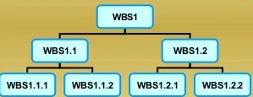

From Work Package to Network
Difference between WBS and Proiect Network:
WBS is hierarchical, while project network is sequential.
Network provides a project schedule by identifying sequential dependencies and timing of project activities.
WBS is used to identifv each project deliverable and organization unit responsible for its accomplishment within budget and within a time duration.
Network sets all project work, resource needs, and budgets into a sequential time frame; WBS does not provide this information.
WBS provides a framework for trackinq costs of deliverables and organization units responsible.
Notes:
هيكل تقسيم العمل (WBS) هرمي، بينما شبكة المشروع تسلسلية.
توفر الشبكة جدولًا زمنيًا للمشروع من خلال تحديد التبعيات التسلسلية وتوقيت أنشطة المشروع.
يُستخدم هيكل تقسيم العمل لتحديد كل مُخرجات المشروع ووحدة التنظيم المسؤولة عن إنجازها ضمن الميزانية والمدة الزمنية المحددة.
تحدد الشبكة جميع أعمال المشروع واحتياجاته من الموارد والميزانيات في إطار زمني تسلسلي؛ ولا يوفر هيكل تقسيم العمل هذه المعلومات.
يوفر هيكل تقسيم العمل إطارًا لتتبع تكاليف المُخرجات ووحدات التنظيم المسؤولة.

Slide 5
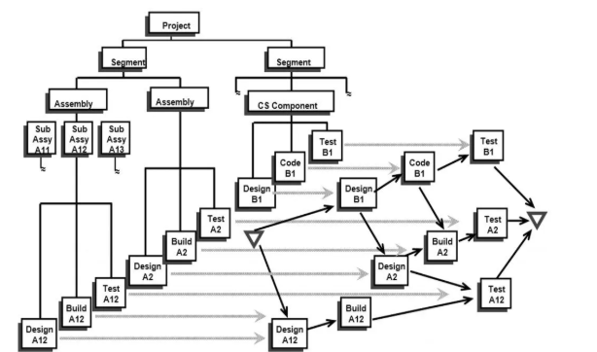
From Work Package to Network
How are WBS and Project Network linked:
Network uses time estimates found in work packages of WBS to develop Network.
Time estimates, budgets, and resources required for a work packages in WBS are set in time frames, but without dates.
Dates are computed after Network is developed.
Notes:
تستخدم الشبكة تقديرات الوقت الموجودة في حزم عمل هيكل تقسيم العمل لتطويرها. تُحدد تقديرات الوقت والميزانيات والموارد اللازمة لحزم العمل في هيكل تقسيم العمل ضمن أطر زمنية، ولكن دون تحديد تواريخ. تُحسب التواريخ بعد تطوير الشبكة.

Slide 6
From Work Package to Network (1/2)
Project networks are developed from the WBS or the responsibility matrix.
The project network is a visual flow diagram of the sequence,
interrelationships, and dependencies of all the activities that must be accomplished to complete the project.
An activity is an element in the project that consumes time.
Work packages from the WBS are used to build the activities found in the
project network.
The activities are placed in a sequence that provides for orderly completion of the project. Networks are built using nodes (boxes) and arrows (lines).
The project manager must be careful to guarantee continuity by having
some of the same people who defined the WBS and work packages develop the network activities.
Networks provide the project schedule by identifying dependencies, sequencing, and timing of activities, which the WBS is not designed to do.
4
Notes:
تُطوَّر شبكات المشاريع بناءً على هيكل تقسيم العمل (WBS) أو مصفوفة المسؤولية.
شبكة المشروع عبارة عن مخطط انسيابي بصري يُظهر التسلسل، والعلاقات المتبادلة، والتبعيات بين جميع الأنشطة التي يجب إنجازها لإتمام المشروع.
النشاط هو عنصر في المشروع يستهلك وقتًا.
تُرتب الأنشطة بتسلسل يضمن إتمام المشروع بشكل منظم. تُبنى الشبكات باستخدام عُقد (مربعات) وأسهم (خطوط).
يجب على مدير المشروع الحرص على ضمان الاستمرارية من خلال الاستعانة ببعض الأشخاص الذين حددوا هيكل تقسيم العمل وحزم العمل لتطوير أنشطة الشبكة.
تُوفر الشبكات الجدول الزمني للمشروع من خلال تحديد التبعيات، وتسلسل الأنشطة، وتوقيتها، وهو ما لم يُصمم هيكل تقسيم العمل للقيام به.

Slide 7
Key Elements of a Network Diagram
To understand network diagrams fully, it is essential to familiarize yourself with their key elements. Let’s explore each element in detail:
Nodes
In a network diagram, nodes represent the various activities or tasks within a project. Each node represents a specific activity that needs to be completed. Nodes are usually depicted as circles or rectangles, and their placement within the diagram signifies their sequence in the project’s flow.
Activities
Activities are the individual tasks or work packages that need to be completed as part of a project. They can be depicted as lines connecting the nodes within the network diagram. Each activity has a specific duration and may have dependencies on other activities.
Dependencies
Dependencies represent the relationships between activities. They indicate the order in which activities should be executed. There are four types of dependencies commonly used in network diagrams:
Finish-to-Start (FS) – The dependent activity cannot start until the preceding activity is finished.
Start-to-Start (SS) – The dependent activity cannot start until the preceding activity has started.
Finish-to-Finish (FF) – The dependent activity cannot finish until the preceding activity has finished.
Start-to-Finish (SF) – The dependent activity cannot finish until the preceding activity has started.
These dependencies play a vital role in determining the critical path and sequencing of activities.
Notes:
To understand network diagrams fully, it is essential to familiarize yourself with their key elements. Let’s explore each element in detail:
Nodes
In a network diagram, nodes represent the various activities or tasks within a project. Each node represents a specific activity that needs to be completed. Nodes are usually depicted as circles or rectangles, and their placement within the diagram signifies their sequence in the project’s flow.
Activities
Activities are the individual tasks or work packages that need to be completed as part of a project. They can be depicted as lines connecting the nodes within the network diagram. Each activity has a specific duration and may have dependencies on other activities.
Dependencies
Dependencies represent the relationships between activities. They indicate the order in which activities should be executed. There are four types of dependencies commonly used in network diagrams:
Finish-to-Start (FS) – The dependent activity cannot start until the preceding activity is finished.
Start-to-Start (SS) – The dependent activity cannot start until the preceding activity has started.
Finish-to-Finish (FF) – The dependent activity cannot finish until the preceding activity has finished.
Start-to-Finish (SF) – The dependent activity cannot finish until the preceding activity has started.
These dependencies play a vital role in determining the critical path and sequencing of activities.
Critical Path
The critical path is the longest sequence of dependent activities in a network diagram. It determines the minimum timeframe required to complete the project. The critical path helps project managers identify the activities that must be completed on time to prevent delays in project delivery.
Float/Slack
Float, also known as slack, refers to the amount of time an activity can be delayed without impacting the project’s overall duration. Activities on the critical path have zero float since any delay in these activities will directly impact the project’s timeline. Activities with float can be delayed without affecting the project’s completion date.
Milestones
Milestones represent significant events or achievements within a project. They are often depicted as diamond-shaped nodes in the network diagram. Milestones help project teams track progress and provide a sense of accomplishment as they reach key points in the project timeline.
By understanding these key elements, project managers can effectively analyze and interpret network diagrams, leading to better project planning and execution.

Slide 8
Critical Path
The critical path is the longest sequence of dependent activities in a network diagram. It determines the minimum timeframe required to complete the project. The critical path helps project managers identify the activities that must be completed on time to prevent delays in project delivery.
Float/Slack
Float, also known as slack, refers to the amount of time an activity can be delayed without impacting the project’s overall duration. Activities on the critical path have zero float since any delay in these activities will directly impact the project’s timeline. Activities with float can be delayed without affecting the project’s completion date.
Milestones
Milestones represent significant events or achievements within a project. They are often depicted as diamond-shaped nodes in the network diagram. Milestones help project teams track progress and provide a sense of accomplishment as they reach key points in the project timeline.
By understanding these key elements, project managers can effectively analyze and interpret network diagrams, leading to better project planning and execution.

Slide 9
Constructing a Project Network
Terminology
Activity: For project managers, an activity is an element of the project that requires time.
It may or may not require resources. Typically, an activity consumes time; either while
people work or while people wait. Examples of the latter are time waiting for contracts
to be signed, materials to arrive, drug approval by the government, budget clearance,
etc. Activities usually represent one or more tasks from a work package. Descriptions of
activities should use a verb/noun format: for example, develop product specifications.
Merge Activity: This is an activity that has more than one activity immediately preceding
it (more than one dependency arrow flowing to it).
Parallel Activities: These are activities that can take place at the same time, if the
manager wishes. However, the manager may choose to have parallel activities not occur simultaneously.
Burst Activity: This activity has more than one activity immediately following it (more
than one dependency arrow flowing from it).
Path: A sequence of connected, dependent activities.
Critical Path: When this term is used, it means the path(s) with the longest duration
through the network; if an activity on the path is delayed, the project is delayed the
same amount of time.
6

Slide 10
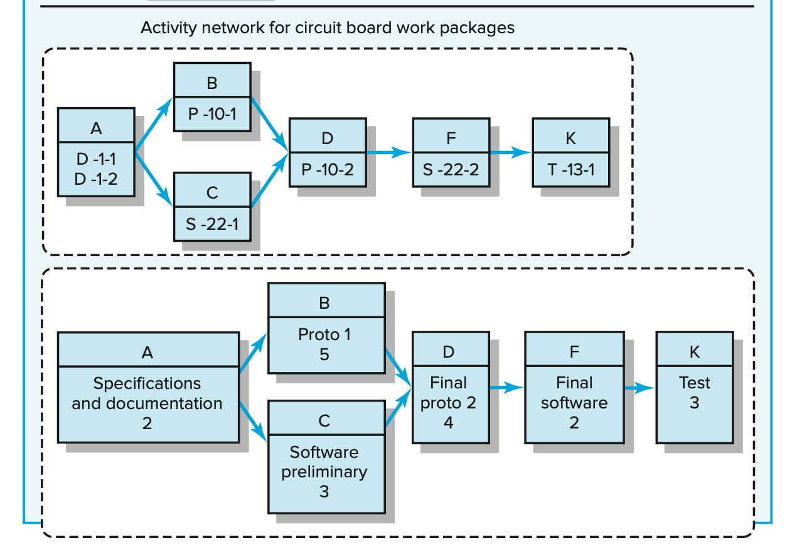
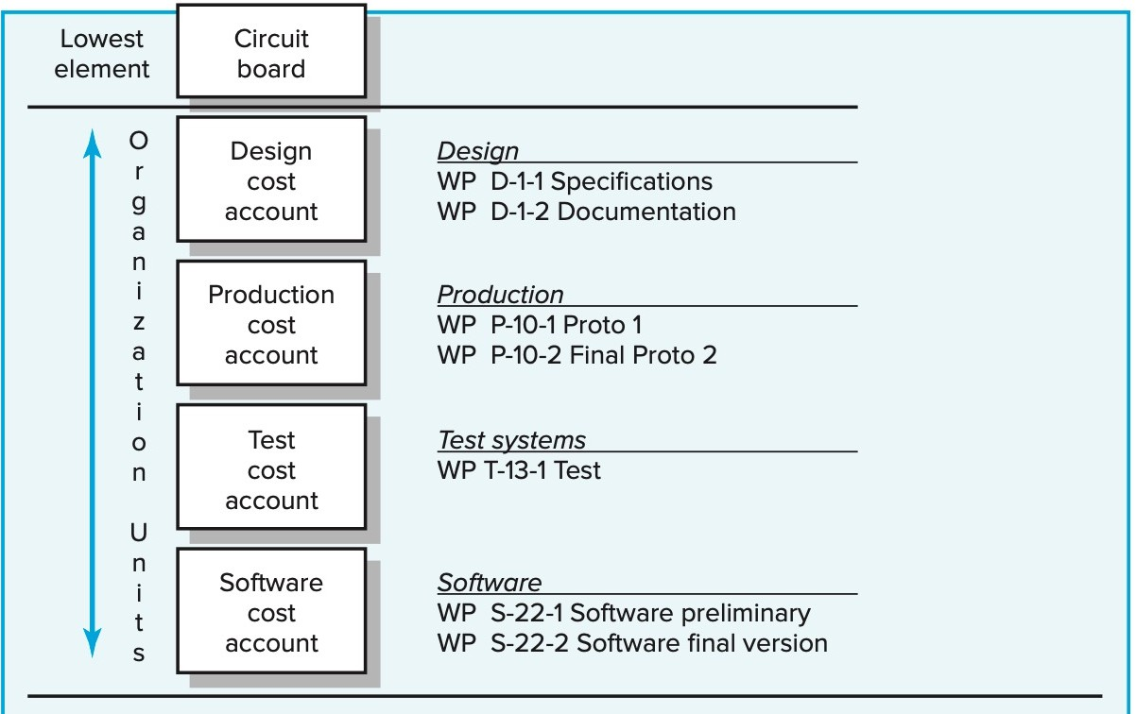
From Work Package to Network (2/2)
Path A B D F K
Burst Activity
Merge Activity
Parallel
Activities
Segment showing WBS/Work Packages to Network
5

Slide 11
Basic Rules to Follow in Developing Project Networks
Networks flow typically from left to right.
An activity cannot begin until all preceding connected activities have been completed.
Arrows on networks indicate precedence and flow. Arrows can cross over each other.
Each activity should have a unique identification number.
An activity identification number must be larger than that of any activities that precede it.
Looping is not allowed (in other words, recycling through a set of activities cannot take place).
Conditional statements are not allowed (that is, this type of statement should not appear: If successful, do something; if not, do nothing).
Experience suggests that when there are multiple starts, a common start node can be used to indicate a clear project beginning on the network. Similarly, a single project end node can be used to indicate a clear ending.

Slide 12
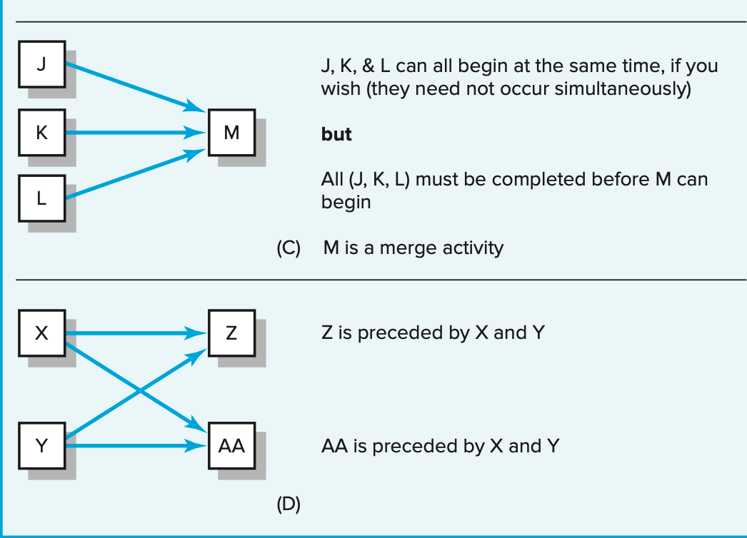
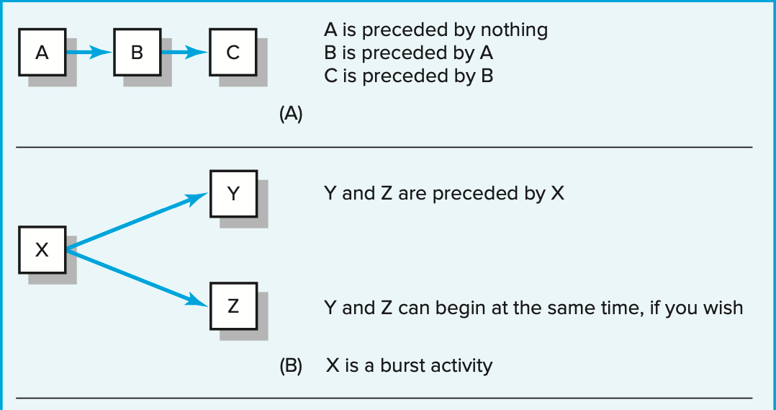
Activity-on-Node (AON) Fundamentals (1/2)
Historically, two methods have been used to develop project networks: Activity- on-node (AON) and Activity-on-arrow (AOA). Over time the availability of advanced computer graphics improved the clarity and visual appeal of the AON method. Today, the activity-on-node method has come to dominate nearly all project network plans.

Slide 13
Activity-on-Node (AON) Fundamentals (2/2)
An activity is represented by a node (box).
The dependencies among activities are illustrated by arrows between the rectangles (boxes) on the AON network. The arrows indicate how the activities are related and the sequence in which things must be accomplished. The length and slope of the arrow are arbitrary and set for convenience of drawing the network.
The letters in the boxes serve here to identify the activities while you learn the fundamentals of network construction and analysis. In practice, activities have identification numbers and descriptions.
There are (3) basic relationships that must be established for activities included in a project network. The relationships can be found by answering the following (3) questions for each activity:
  Which activities must be completed immediately before this activity? These activities are called predecessor
activities.
  Which activities must immediately follow this activity? These activities are called successor activities.
  Which activities can occur while this activity is taking place? This is known as a concurrent or parallel
relationship.

Slide 14
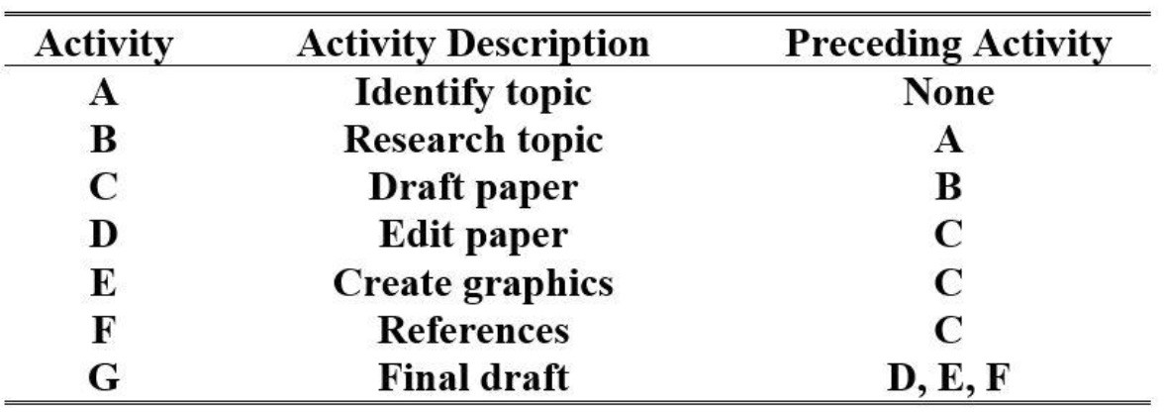
Example 1

Slide 15
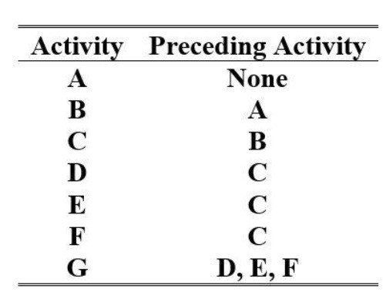
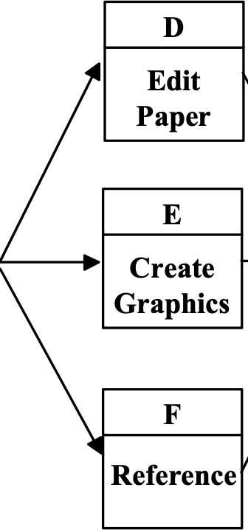
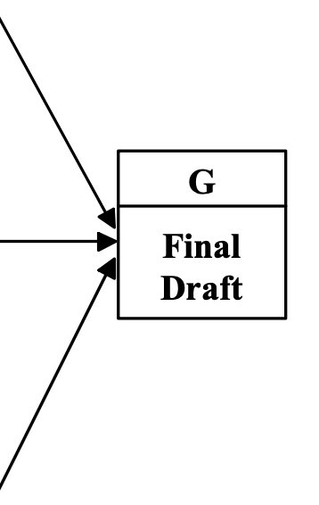
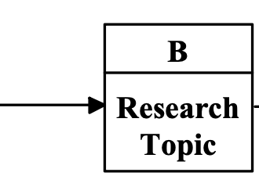
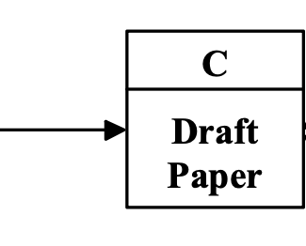
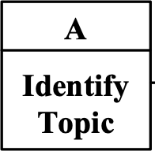
Solution 1

Slide 16
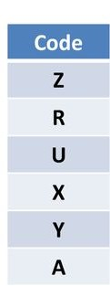
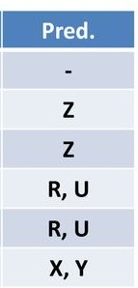
Example 2
U
X
Z
A
R
Y

Slide 17
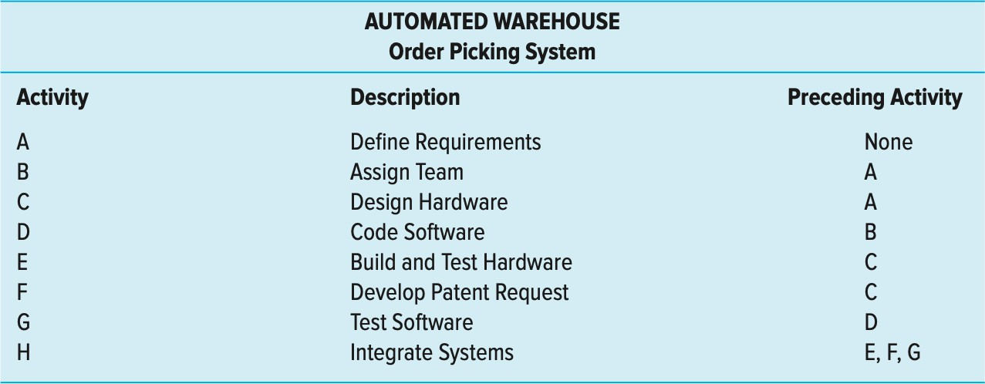
Example 3
New automated warehouse system for picking frozen food package orders and moving them to a staging area for delivery to stores

Slide 18
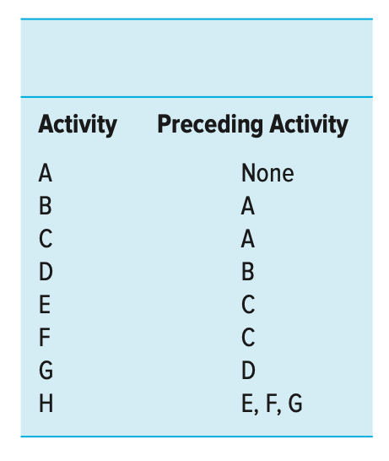
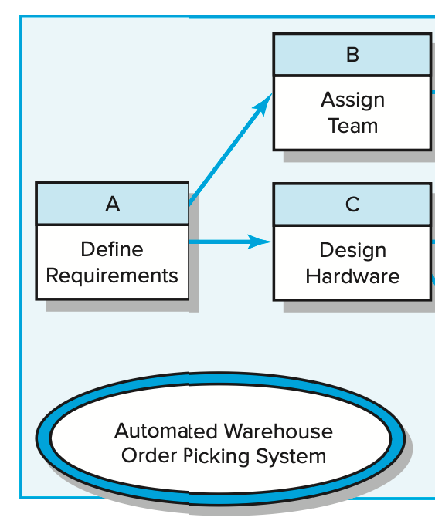
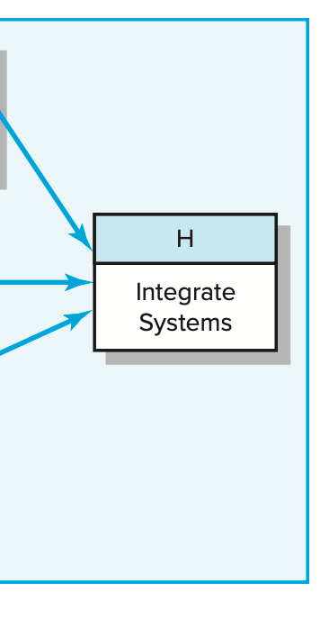
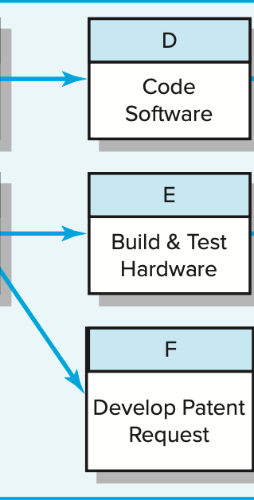
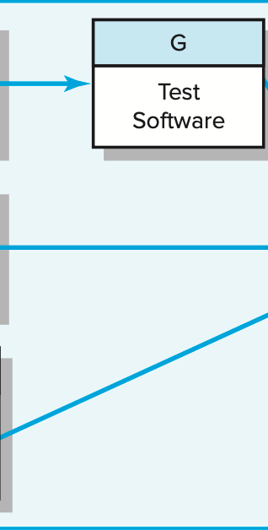
Solution 3

Slide 19
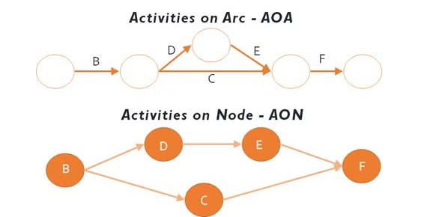

Slide 20
Network Computation Process (1/2)
Drawing the project network places the activities in the right sequence for computing start and finish times of activities.
Activity time estimates are taken from the task times in the work package and added to the network.
Performing a few simple computations allows the
project manager to complete a process known as the forward and backward pass.

Slide 21
Network Computation Process (2/2)
Completion of the forward and backward pass will answer the following questions:
Forward Pass—Earliest Times
  How soon can the activity start? (early start—ES)
  How soon can the activity finish? (early finish—EF)
  How soon can the project be finished? (expected time—TE)
Backward Pass—Latest Times
How late can the activity start? (late start—LS)
How late can the activity finish? (late finish—LF)
Which activities represent the critical path (CP)? This is the longest path in the network which, when delayed, will delay the project.
How long can the activity be delayed? (slack or float—SL)
16

Slide 22
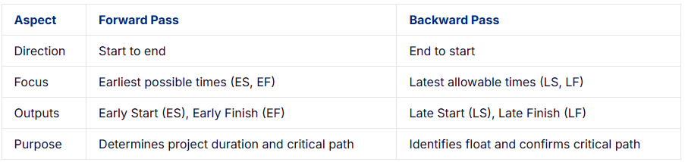
Key Differences Between Forward Pass and Backward Pass
Notes:
The forward pass and backward pass are essential calculations in the Critical Path Method (CPM) for project planning, each serving distinct purposes in determining project timelines and flexibility. Below are the key differences between the two:
1. Direction of Calculation
Forward Pass: Moves from the start of the project to the end, progressing through the project network in chronological order.
Backward Pass: Moves from the end of the project to the start, working backward through the network.
2. Focus
Forward Pass: Determines the earliest possible start (ES) and finish (EF) times for each activity, establishing the shortest project duration.
Backward Pass: Calculates the latest allowable start (LS) and finish (LF) times for each activity to meet the project deadline without delays.
3. Outputs
Forward Pass: Produces Early Start (ES) and Early Finish (EF) for each activity, identifying the earliest project completion time.
Backward Pass: Yields Late Start (LS) and Late Finish (LF) for each activity, indicating the latest times tasks can occur without impacting the project.
4. Role in CPM
Forward Pass: Establishes the project’s critical path and minimum duration by calculating the earliest completion times.
Backward Pass: Identifies float/slack (scheduling flexibility) for activities and confirms the critical path by determining which tasks have no leeway.
How Forward Pass and Backward Pass Work Together
The forward pass and backward pass in the Critical Path Method (CPM) work together to create a clear, practical project schedule.
Forward Pass: Calculates the earliest start (ES) and early finish (EF) times for each task, setting the shortest project timeline and identifying the critical path.
Backward Pass: Determines the latest start (LS) and late finish (LF) times, revealing float (flexibility) for non-critical tasks to avoid delays.
Collaboration: The forward pass establishes the fastest timeline, while the backward pass ensures tasks stay within allowable limits, optimizing scheduling and resource use.
Example: In a 7-day project, the Forward Pass establishes the critical path, and the Backward Pass identifies available float for non-critical tasks, allowing for better resource allocation and efficient scheduling.
Calculating Float/Slack Using Forward and Backward Pass
Float (or slack) is the amount of time a task can be delayed without affecting the project’s overall completion date. It helps project managers identify which tasks are flexible and which ones are critical to the timeline.
(For more details on Float/Slack, check out our comprehensive guide on Float in project management)
How to Calculate Float:
Key Terms:
Earliest Start (ES): The earliest time a task can begin, calculated during the Forward Pass.
Earliest Finish (EF): The earliest time a task can finish, calculated during the Forward Pass.
Latest Start (LS): The latest time a task can start without delaying the project, calculated during the Backward Pass.
Latest Finish (LF): The latest time a task can finish without delaying the project, calculated during the Backward Pass.

Slide 23
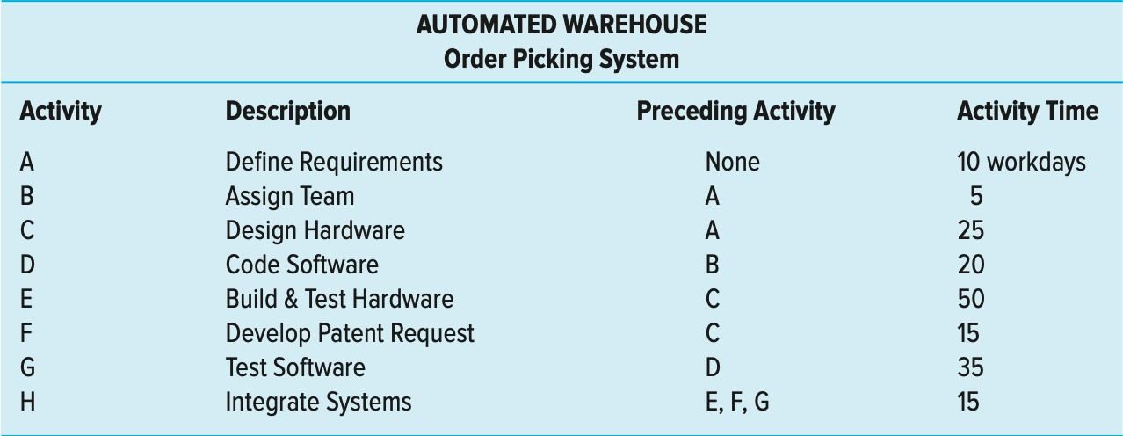
Forward Pass—Earliest Times (1/3)
The forward pass starts with the first project activity(ies) and traces each path (chain of sequential activities) through the network to the last project activity(ies).
As you trace along the path, you add the activity times. The longest path denotes the project completion time for the plan and is called the critical path (CP)

Slide 24
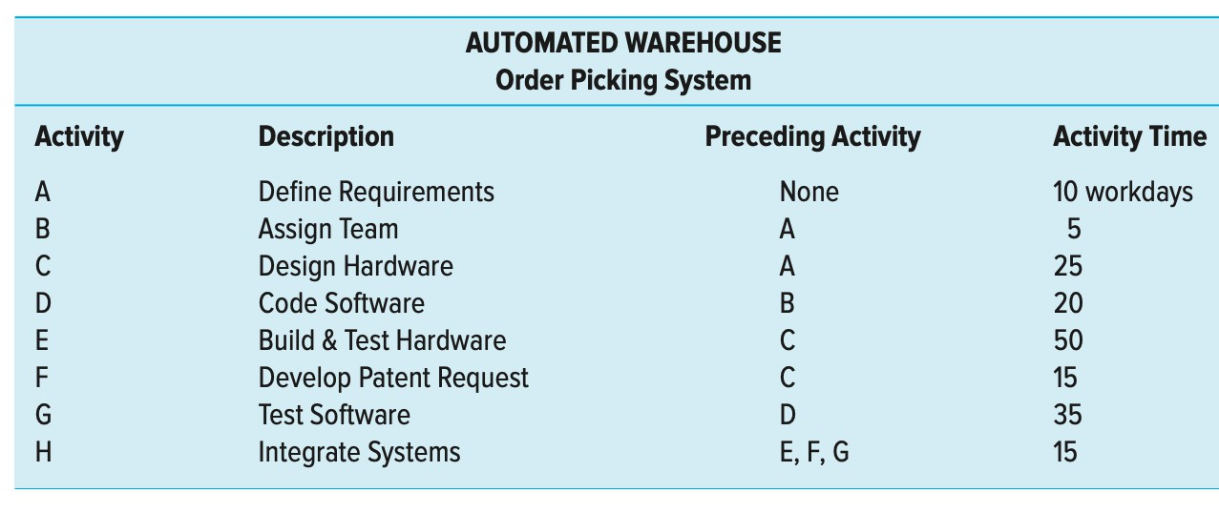
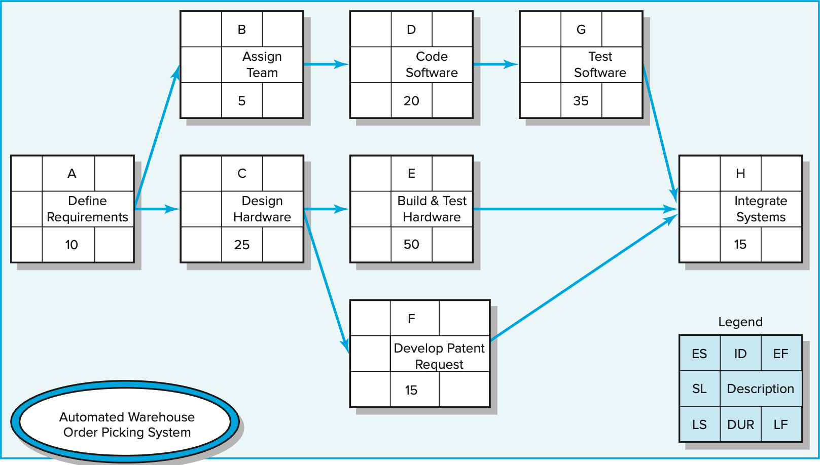
Forward Pass—Earliest Times (2/3)
Early start time (activity A) = zero.
The early finish for activity A = EF = ES + DUR or 0 + 10 = 10.
Earliest activities B and C can begin as soon as activity A is completed
Early finish (EF) times for activities B and C are 15 and 35 days.
EF = ES + DUR

Slide 25
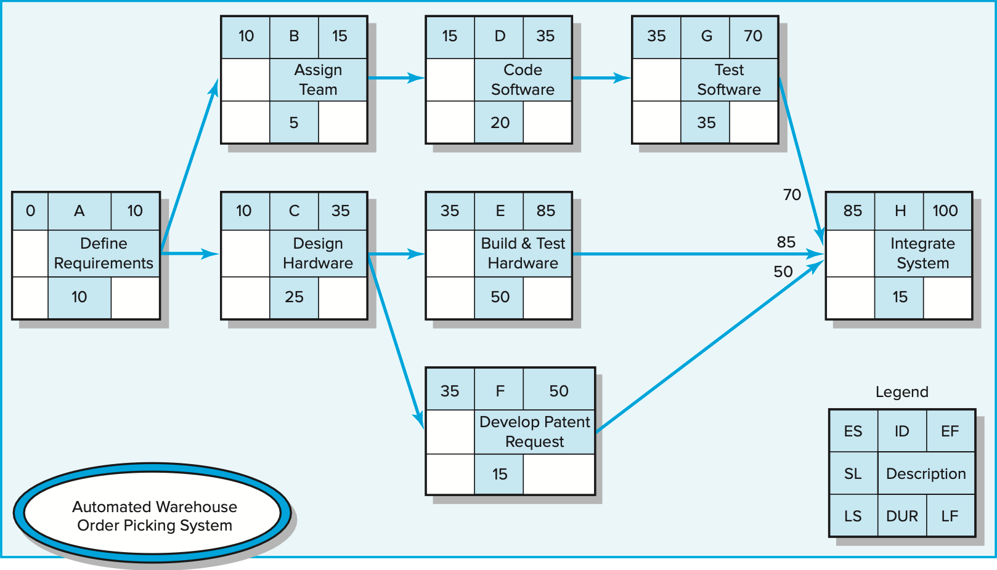
Forward Pass—Earliest Times (3/3)
Activity D: ES = 15 EF = 15 + 20 = 35
Activity E: ES = 35 EF = 35 + 50 = 85
Activity F: ES = 35 EF = 35 + 15 = 50
Activity G: ES = 35 EF = 35 + 35 = 70
You add activity times along each path in the network (ES
+ DUR = EF).
You carry the early finish (EF) to the next activity where it becomes its early start (ES), or If the next succeeding activity is a merge activity, you select the largest early finish number (EF) of all its immediate
predeces₁s₉or
activities.

Slide 26
Example Project 2
Activities:
A: Duration = 4 days
B: Duration = 3 days (depends on A)
C: Duration = 2 days (depends on A)
D: Duration = 5 days (depends on B and C)
E: Duration = 1 day (depends on D)
Forward Pass Calculation
Activity A:
  ES = 0 (starts at the beginning)
  EF = ES + Duration = 0 + 4 = 4
Activity B: (depends on A)
  ES = EF of A = 4
  EF = ES + Duration = 4 + 3 = 7
Activity C: (depends on A)
  ES = EF of A = 4
  EF = ES + Duration = 4 + 2 = 6
Activity D: (depends on B and C)
  ES = max(EF of B, EF of C) = max(7, 6) = 7
  EF = ES + Duration = 7 + 5 = 12
Activity E: (depends on D)
  ES = EF of D = 12
  EF = ES + Duration = 12 + 1 = 13

Slide 27
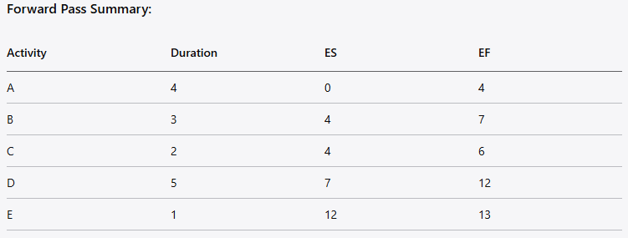

Slide 28
Backward Pass—Latest Times (1/2)
The backward pass starts with the last project activity(ies) on the network. You trace backward on each path subtracting activity times to find the late start (LS) and late finish (LF) times for each activity.
Before the backward pass can be computed, the late finish for the last project activity(ies) must be selected.
In early planning stages, this time is usually set equal to the early finish (EF) of the last project activity (or in the case of multiple finish activities, the activity with the largest EF). In some cases, an imposed project duration deadline exists, and this date will be used

Slide 29
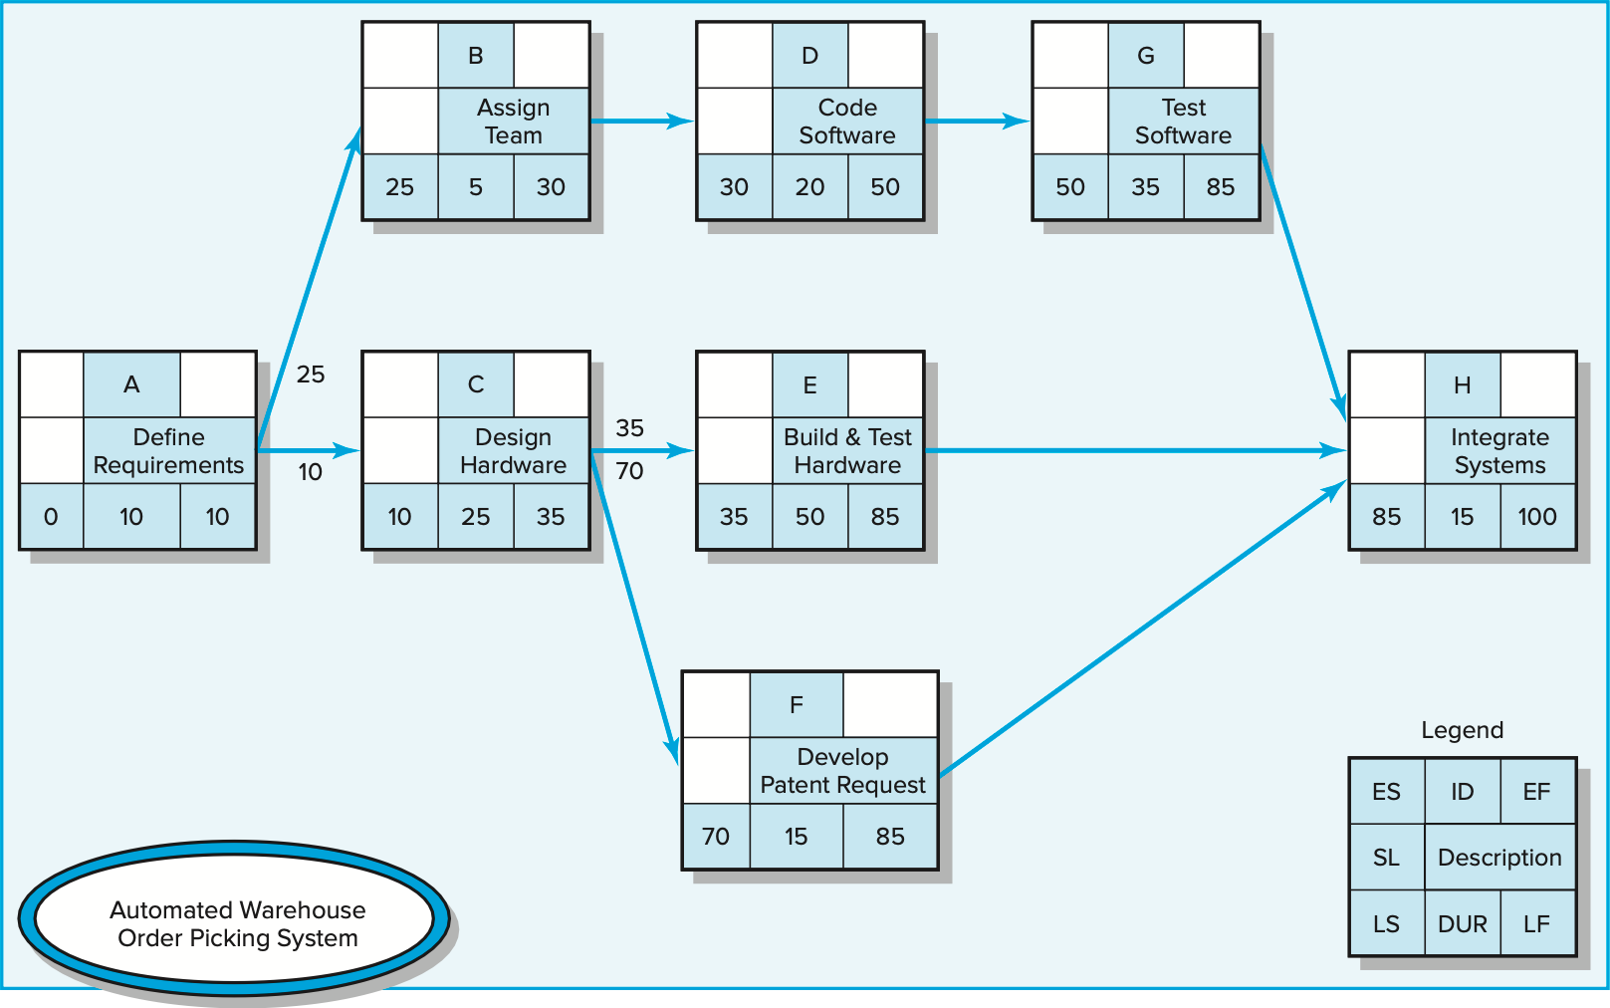
Backward Pass—Latest Times (2/2)
Assume for planning purposes that EF = LF
Starting with the project end activity, LF − DUR = LS.
Carry the LS to the preceding activity to establish its LF, or If the next preceding activity is a burst activity;
you select the smallest LS of all its immediate successor activities to establish its LF.
Activity E: LS = 85 − 50 = 35 Activity G: 85 − 35 = 50
Activity F: LS = 85 − 15 = 70

Slide 30
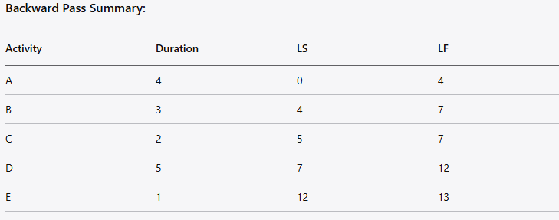
Example Project 2
Activity E: (last activity)
LF = EF of E = 13
LS = LF - Duration = 13 - 1 = 12
Activity D:
LF = LS of E = 12
LS = LF - Duration = 12 - 5 = 7
Activity C:
LF = min(LS of D) = 7
LS = LF - Duration = 7 - 2 = 5
Activity B:
LF = min(LS of D) = 7
LS = LF - Duration = 7 - 3 = 4
Activity A:
LF = min(LS of B, LS of C) = min(4, 5) = 4
LS = LF - Duration = 4 - 4 = 0

Slide 31
Determining Slack (SL) (1/2)
Total slack (or float) is the amount of time an activity can exceed its early finish date without affecting the project end date.
For each activity, it is the difference between the LS and ES (LS − ES = SL) or between LF and EF (LF − EF = SL)
After slack for each activity is computed, the critical path(s) is (are) easily identified. When the LF = EF for the end project activity, the critical path can be identified as those activities that also have LF = EF or a slack of zero (LF − EF = 0 or LS − ES = 0).
The critical path is the network path(s) that has (have) the least slack in common.

Slide 32
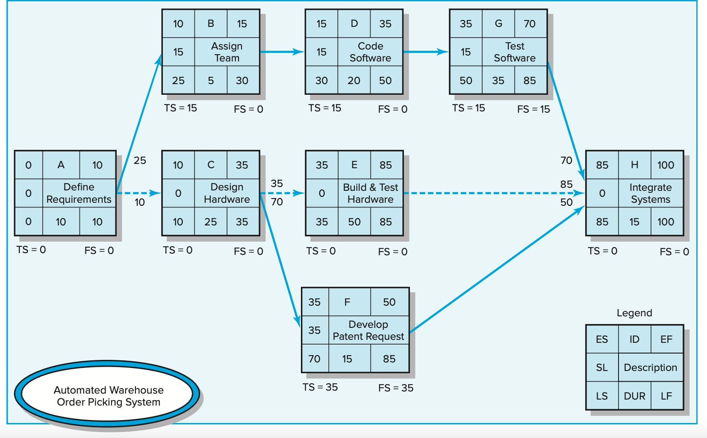
Determining Slack (SL) (2/2)
If total slack of one activity in a path is used, the ES for all activities that follow in the chain will be delayed and their slack reduced.
Use of total slack must be
coordinated with all participants in the activities that follow in the chain.
Critical activities typically
represent about 10% of the activities of the project. Therefore, project managers pay close attention to the critical path activities to be sur₂e₃ they are not delayed

Slide 33
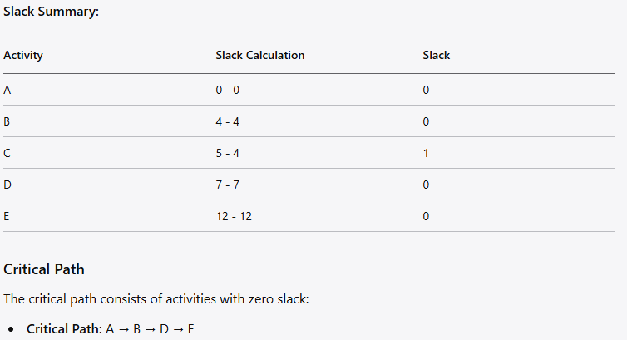
Example Project 2
Total Project Duration: 13 days
Critical Path Activities: A, B, D, E

Slide 34
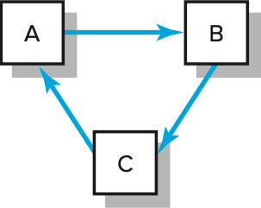
Practical Considerations (1/3)
Network Logic Errors
  Conditional statements such as “if test successful build the prototype, if failure redesign” are not permitted.
  Avoid looping. Looping is an attempt by the planner to return to an earlier activity.
Illogical Loop
Activity Numbering: Activity numbering systems should be ascending and as simple as possible. Each activity needs a unique identification code. It is customary to leave gaps between numbers (1, 5, 10, 15 . . .). Gaps are desirable so you can add missing or new activities later.

Slide 35
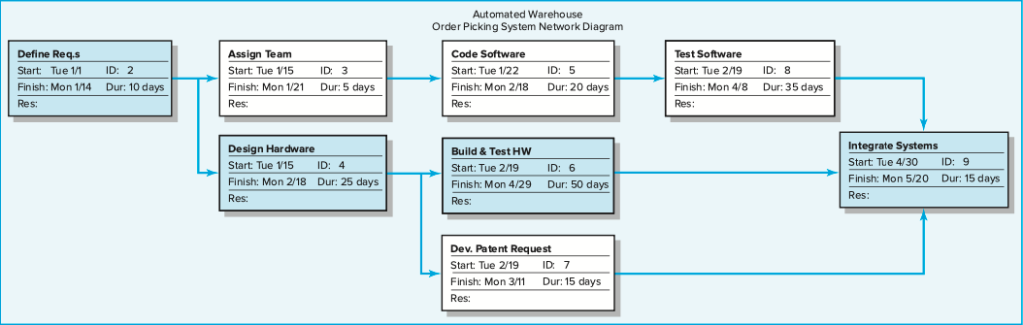
Practical Considerations (2/3)
3. Use of Computers to Develop Networks

Slide 36
Practical Considerations (3/3)
Calendar Dates: Assign calendar dates to your project activities. This can
be done manually if a computer program is not used. Most computer
programs will assign calendar dates automatically after you identify start dates, time units, non-workdays, and other information.
Multiple Starts and Multiple Projects: Some computer programs require a
common start and finish event in the form of a node. Even if this is not a
requirement, it is a good idea because it avoids “dangler” paths. Dangler
paths give the impression that the project does not have a clear beginning
or ending. If a project has more than one activity that can begin/end when
the project is to start/finish, each path is a dangler path. Danglers can be
avoided by tying dangler activities to a common project start or finish node.
When several projects are tied together in an organization, using a
common start and end node helps to identify the total planning period of
all projects. Use of dummy wait activities from the common start node allows different start dates for each project.

Slide 37
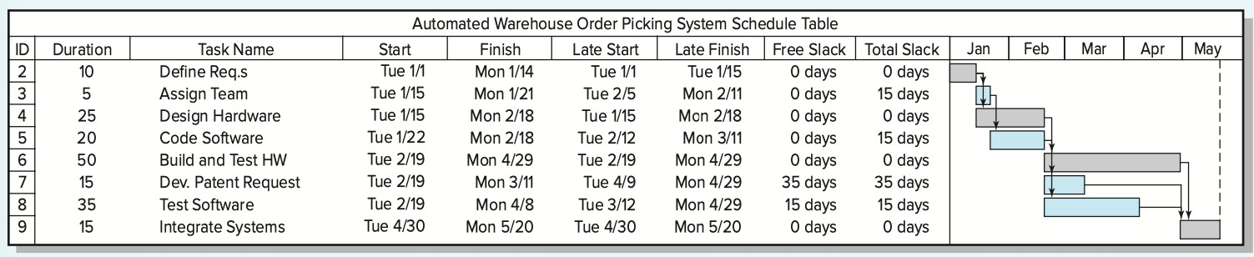
Gantt Chart (1/2)
Gantt* chart: Bar charts are popular because they present an easy-to-understand, clear picture on a time-scaled horizon. They are used during planning, resource scheduling, and status reporting. The format is a two-dimensional representation of the project schedule, with activities down the rows and time across the horizontal axis.
In this computer output the shaded bars represent the activity durations. The extended lines from the bars represent slack. For example, “test software” (ID # 8) has a duration of 35 days (shaded area of the bar) and 15 days slack (represented by the extended line). The bar also indicates test software has an early start of February 19 and would finish April 8, but can finish as late as April 29 because it has 15 days of slack. When calendar dates are used on the time axis, Gantt charts provide a clear overview of the project schedule and can often be found posted on the walls of project offices.
Microsoft Project
27
* Gantt charts were introduced over 100 years ago by Henry Gantt

Slide 38
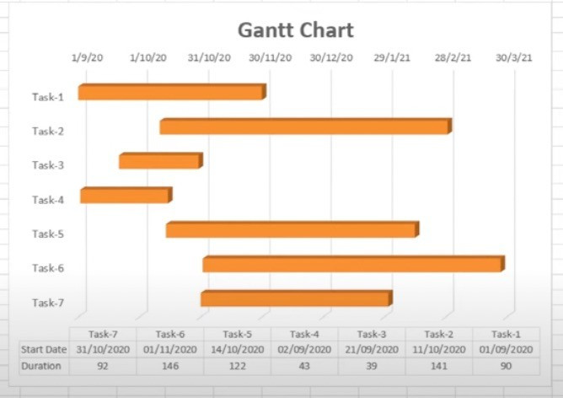
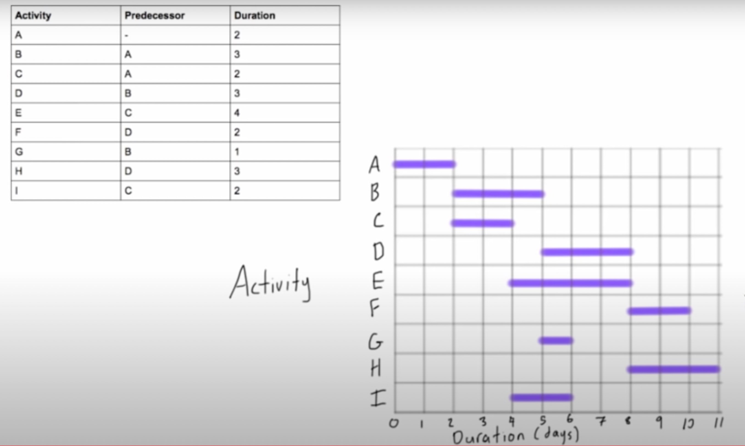




Gantt Chart (2/2)
Slack
Microsoft Excel
Not required in the project
Manual
On the graph paper in the exam
28
Notes:
When it comes to project planning and scheduling, both Gantt charts and network diagrams play significant roles. Let’s compare these two tools:
Definition and Purpose
A Gantt chart is a horizontal bar chart that visually represents project tasks, their durations, and their interdependencies. It provides a timeline view of the project and allows project managers to track progress and identify potential delays. On the other hand, a network diagram visually represents the flow and dependencies between activities, showcasing the logical sequence of tasks.
Visual Presentation
Gantt charts present project tasks and their durations in a sequential manner, displaying them on a timeline. They offer a clear overview of project progress and help project managers monitor the completion status of tasks. Network diagrams, on the other hand, focus on the relationships and dependencies between activities and provide a visual representation of project flow.
Level of Detail
Gantt charts offer a high level of detail, displaying individual tasks along with their durations, dependencies, and progress. They are widely used for day-to-day project tracking and monitoring. Network diagrams, however, provide a higher-level view, showcasing the flow and dependencies between activities rather than specific task details.
Focus on Time
Gantt charts emphasize time by presenting tasks on a timeline. They enable project managers to track project progress against predetermined schedules and identify any deviations. Network diagrams, on the other hand, highlight the logical flow and sequencing of activities, helping project managers understand the relationships and dependencies between tasks.
Complexity and Scalability
Gantt charts are well-suited for smaller projects with a limited number of tasks and dependencies. They can quickly become cluttered and difficult to read when used for larger and more complex projects. Network diagrams, on the other hand, handle complexity and scalability more effectively, making them suitable for projects with numerous activities and dependencies.
Both Gantt charts and network diagrams have their benefits and serve different purposes in project management. Project managers often use them in conjunction to achieve a comprehensive view of project planning, scheduling, and progress tracking.

